Slide 1
P5 project work 2016 p5 joy
Done by smart captain

Slide 2
Earth was once a cool place

Slide 3
But now thanks to global warming , earth is getting hotter like this

Slide 4
If we want earth to be like before, we have to practise the 3rs.

Slide 5
suggestion 1
Cook your leftover food to eat the next day to reduce food waste.
Keep and cook your leftover food instead of throwing them away, thus helping to reduce food wastage at home.

Slide 6
suggestion 2
Use fan instead of air-con so you save money.
This are the watts.
A window unit AC uses 500 to 1440 watts, while a 2.5-ton central system uses about 3500 watts. That's a lot of power. A floor fan uses only 100 watts on the highest speed, and ceiling fans use only 15 to 90 watts depending on speed and size.

Slide 7
suggestion 3
Recycle plastic bottles!
As a school, if we recycle 1000 bottles a month, it will be 12 000 bottles a year! So keep recycling.
It saves a lot of natural resources, like crude oil!

Slide 8
suggestion 3
If we have $500,
We will put up posters at the canteen and around the school to remind everyone to recycle their plastic bottles.
We will put up more recycling bins around the school.

Slide 9
We can save the earth together.

Slide 10
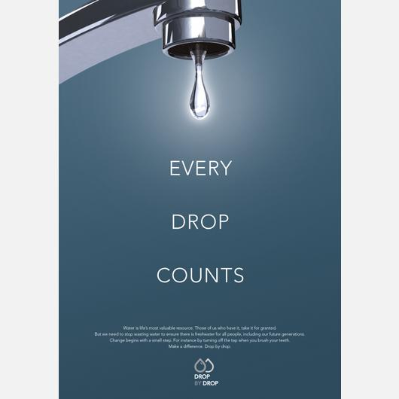
Done by
Clemence, Patricia ,Yuki and Iskandar

Slide 11
Reflection
We learnt a lot about greenhouse gases, pollution and food waste thanks to this project . We now know how to live a more sustainable lifestyle. We learnt about reuse, reduce and recycle.

Slide 12
Resources
http://www.livestrong.com/article/181103-the-effect-of-recycling-plastic-water-bottles-on-the-environment/

Slide 13
Thank you for listening!!!!!

