Slide 1
Lights Of Our Future
Presented to you by:
The Awesome Conservationists
5 Care
Queenstown Primary School
Notes:
Good afternoon teachers and friends , we are the Awesome Conservationists from 5 Care. Today , we will be showing you our project.

Slide 2
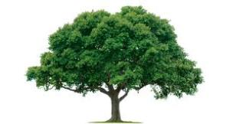
Here are the reasons why environmental conservation practices are crucial for future generation.
Save the
To ensure that the future generation has sufficient food, water and resources .
To ensure that the future generation has a better place to live in.
To ensure that there will not be any major natural disasters in the future.
Notes:
Here are some of the reasons why……….[according to the slides]

Slide 3
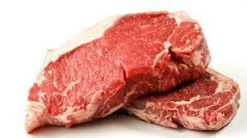
Sustainable Green Idea 1
No-Meat Day
-Eat a vegetarian meal with vegetables and fruits once a week
-Students who are participating in strenuous sports and CCA can have rice with vegetables and fruits for lunch.
-For nutrients unavailable in vegetables and fruits and found in meat, eat peas and nuts.
Notes:
The first Sustainable green idea is No-Meat Day . On no-meat day , students…….[first and second point].

Slide 4
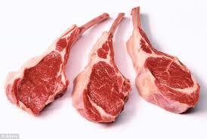
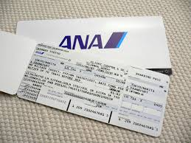
Sustainable Green Idea 1
Impact:
-For 1 pound(0.453592kg)of beef produced,2500 gallons(9463.529L)
of water is used. The more meat you eat , the more amount of
water of the Earth Is used.
-For each hamburger that originated from animals raised on the
rainforest land approximately 55 square feet of trees and forest have
been destroyed.
-By not eating meat you save water ,trees and forests.
A reduction in meat consumption by 50% would have the effect of reducing almost 750kg of CO2 per year.
You can save up to $5250 and you can have about 5 tickets to Japan!
Savings:
For one kilogram of meat,it cost about $5 to $10.
Notes:
The impact of eating meat is……[according to slide]. We will save up to $5 to $10 for one kg of meat…………[according to slide].

Slide 5
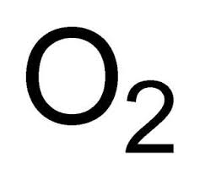
Sustainable Green Idea 2
Plant-A–Tree-Campaign
-To make the school more cooler and green.
-To make sure that the students will not depend on
air-conditioners and fans.
-To reduce the CO2 emissions in the air caused by
the electrical appliances.
-Every year on a certain day, we will plant a tree in
the school compound.
Notes:
This is our 2nd idea which is Plant-A-Tree-Campaign. Every year……..[according to slide].

Slide 6
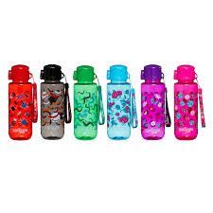
Sustainable Green Idea 2
Impact:
-When it is carrying out photosynthesis, it takes in
carbon dioxide that we breathe out.
-The plants will give out oxygen and make the
classrooms cooler.
-This will help to reduce the carbon dioxide
emissions.
Savings:
Air conditioner fee=$10
Number of air-conditioners in school=17 savings=$170
We can buy about 8 water bottles from Smiggle!
Notes:
[Read like Slide 4]

Slide 7
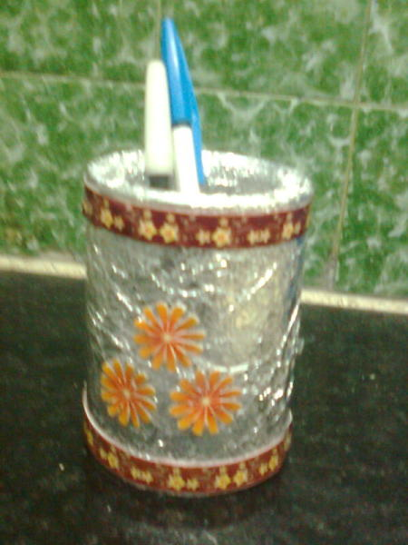
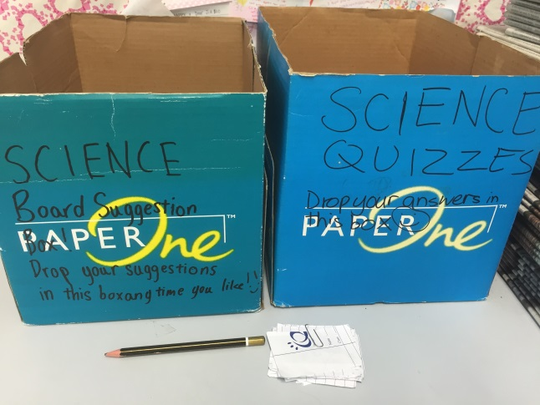
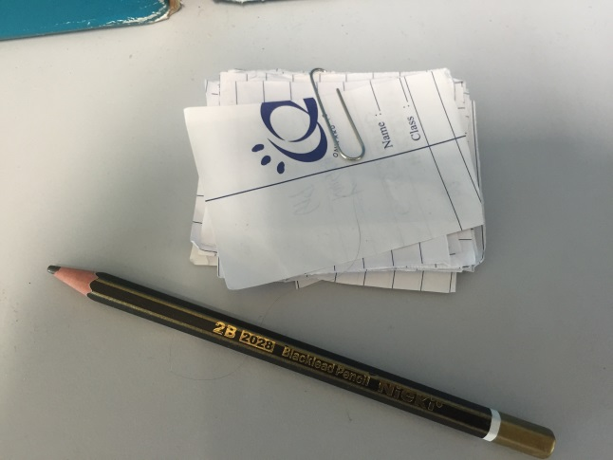
Sustainable Green Idea 3
Use Of Waste Materials
-We can use leftover food as fertiliser
-The plants will get more nutrients when applied to the soil.
-We can use also scraps of paper and boxes to make Science quizzes etc.
Notes:
Our 3rd idea is to use of waste materials . Some examples are using leftover food as fertiliser .This is beneficial as {according to slides point number 2}.For some academic fun, we can{according to point number 3}

Slide 8
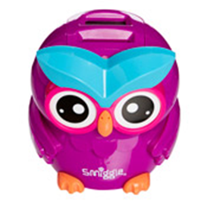
Sustainable Green Idea 3
Impact:
-As the waste materials are recycled and not burnt ,it is eco-friendly.
-In this way, it does not emit greenhouse gases that pollute the environment.
-It also saves energy.
Savings:
A set of Foolscap paper:$1
Two boxes: $2
Total savings:$3
With that, you can buy a counting money box
from Smiggle!
Notes:
{Read like slide 6}

Slide 9
What are the possible problems in implementing these 3 ideas?
Idea 1
Problem: Some pupils do not like to eat vegetables and fruits only.
Solution: Educate them about the impact of eating meat and the benefits of eating more vegetables.
Idea 2
Problem: Some pupils do not want to get their hands dirty from gardening.
Solution: Give them free products to encourage them to participate in the campaign actively.
Idea 3
Problem: There is no facility available for making fertiliser and some pupils have no habit of collecting the wastepaper.
Solution: Teach pupils simple ways of making fertiliser and provide them a bin for collecting wastepaper.
Notes:
Here are the possible problems :for idea 1:{read according to point 1},for idea 2:[according to point 2],for idea 3[according to point 3]

Slide 10
What your team’s wish towards turning Singapore into a ‘Green’ global city state.
We wish that:
-All Singaporeans will have awareness to protect the environment.
-They will turn awareness into action carrying out eco-friendly practices.
Notes:
Here our team’s wishes[according to the slide.]

Slide 11
Given $500…
For Sustainable Idea 1, each vegetarian set cost $2.50.
$500.00 ÷ $2.50 =200. We can feed 200 people in school.
If they have at least 40% less meat consumption, 200 × 594 kg of CO2 emissions =118800 kg of saved CO2 emissions.

Slide 12
Given $500…
For Sustainable Idea 2,
small trees can cost $20.
$500÷$20=25. We can buy 25 trees.
There are 20 air conditioners in the school.
20×$30 (the cost of air conditioning fee)=$600.
We can save $600. Power plants save 100 million tonnes of CO2 emissions every year.

Slide 13
Acknowledgement
We would like to thank:
- Our teacher, Ms Tan
- Our principal and vice principals Mrs Chua, Mrs Tan
and Mdm Poon
- Our parents
http://www.yousustain.com/footprint/actions
Notes:
We would like to thank[according to the slide.]

Slide 14
What we enjoyed:
*Looking for inspirations that helped us to come up with ideas.
*Creating this project.
What we found difficult:
*To work as a team.
*To calculate our savings for each idea.
*Thinking of ideas.
The greatest strength of this project is :
*Teamwork
*To communicate with each other.
Notes:
Here is our team’s reflection[according to the slide.]

Slide 15
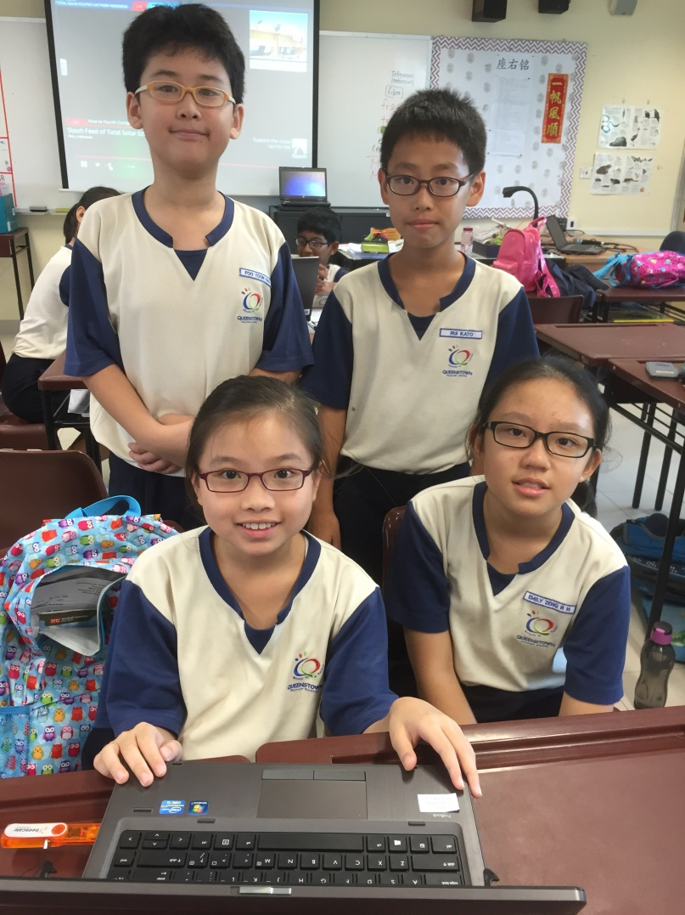
Done by ( The Awesome Conservationists)
Foo Toon Hao
Kato Rui
Emily Zeng Ruo Hua
Ng Tze Xuan
Notes:
The team consists of Foo Toon Hao , Kato Rui, Emily Zeng Ruo Hua and Ng Tze Xuan.

