Slide 1

15K Competition
NUS & SMU
June 2022 Updated

Slide 2
What is the 10K (now 15K)?
The MIT $100K
One competition – three independent contests – from September through May. For 25 years, the MIT $100K Entrepreneurship Competition has been bringing together students and researchers from across MIT and Greater Boston to launch their talent, ideas, and technology into leading companies. The competition is run as a series of distinct, increasingly intensive contests: Pitch, Accelerate, and Launch.
Each contest focuses on developing specific founding skills, and for each semi-finalist contender the MIT $100K brings together a network of resources, including mentorship from venture capitalists, serial entrepreneurs, corporate executives, and attorneys; media exposure; prototyping funds; business plan feedback; and discounted services. Additionally, more than $300K in non-dilutive awards help these new ventures accelerate.
SUTD Entrepreneurship competition modeled on MIT’s 100K competition
MIT’s 100K competition started 25 years ago as the 10K. Then became 50K in 1996. And now, 100K.
Today, the 100K is a huge annual event at MIT, with the Launch finals watched by thousands, and sponsored by a hosts of top class companies and foundations
More than 60 companies worth more than $10 billion have been launched, including Akamai, net.genesis and C-bridge
http://www.mit100k.org/

Slide 3
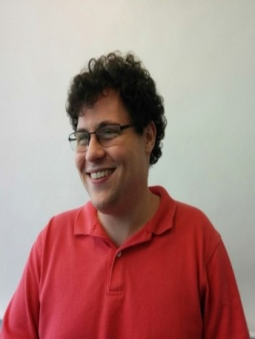
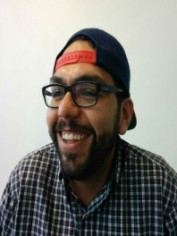
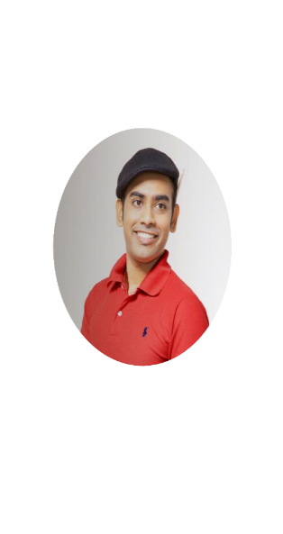
The SUTD $10k is a student-run business innovation competition modelled after the MIT $100k where student teams, selected by the strength of their ideas, are matched with experienced mentors for one month to develop original and compelling business models. The team with the most compelling final pitch is given $10,000 to move their idea forward. Your sponsorship directly supports innovative student businesses in Singapore.
“Motivated students and researchers from SUTD are constantly developing innovative technologies and processes, but need help bringing those technologies to market”.. The Founding Team of SUTD 10K
The MIT Club of Singapore, a non-profit volunteer organization of MIT alumni, supported and funded the first 4 editions of the competition (2016 to 2019).
Susan Conover
10k Director & Event Coordinator
MIT, UT Austin, SUTD
Biotech entrepreneur
100k alumna
David Anderson
10k Sponsorship
MIT, SUTD
Startup work experience
100k alumnus
Blake Perez
10k Mentorship
UT Austin, Virginia Tech, SUTD
Expert in team formation and innovation
Kabin Calan
10k Marketing
SUTD, GST
Design researcher
Former SUTD student body president

Slide 4
2016
Inaugural SUTD 10K Winners

Slide 5
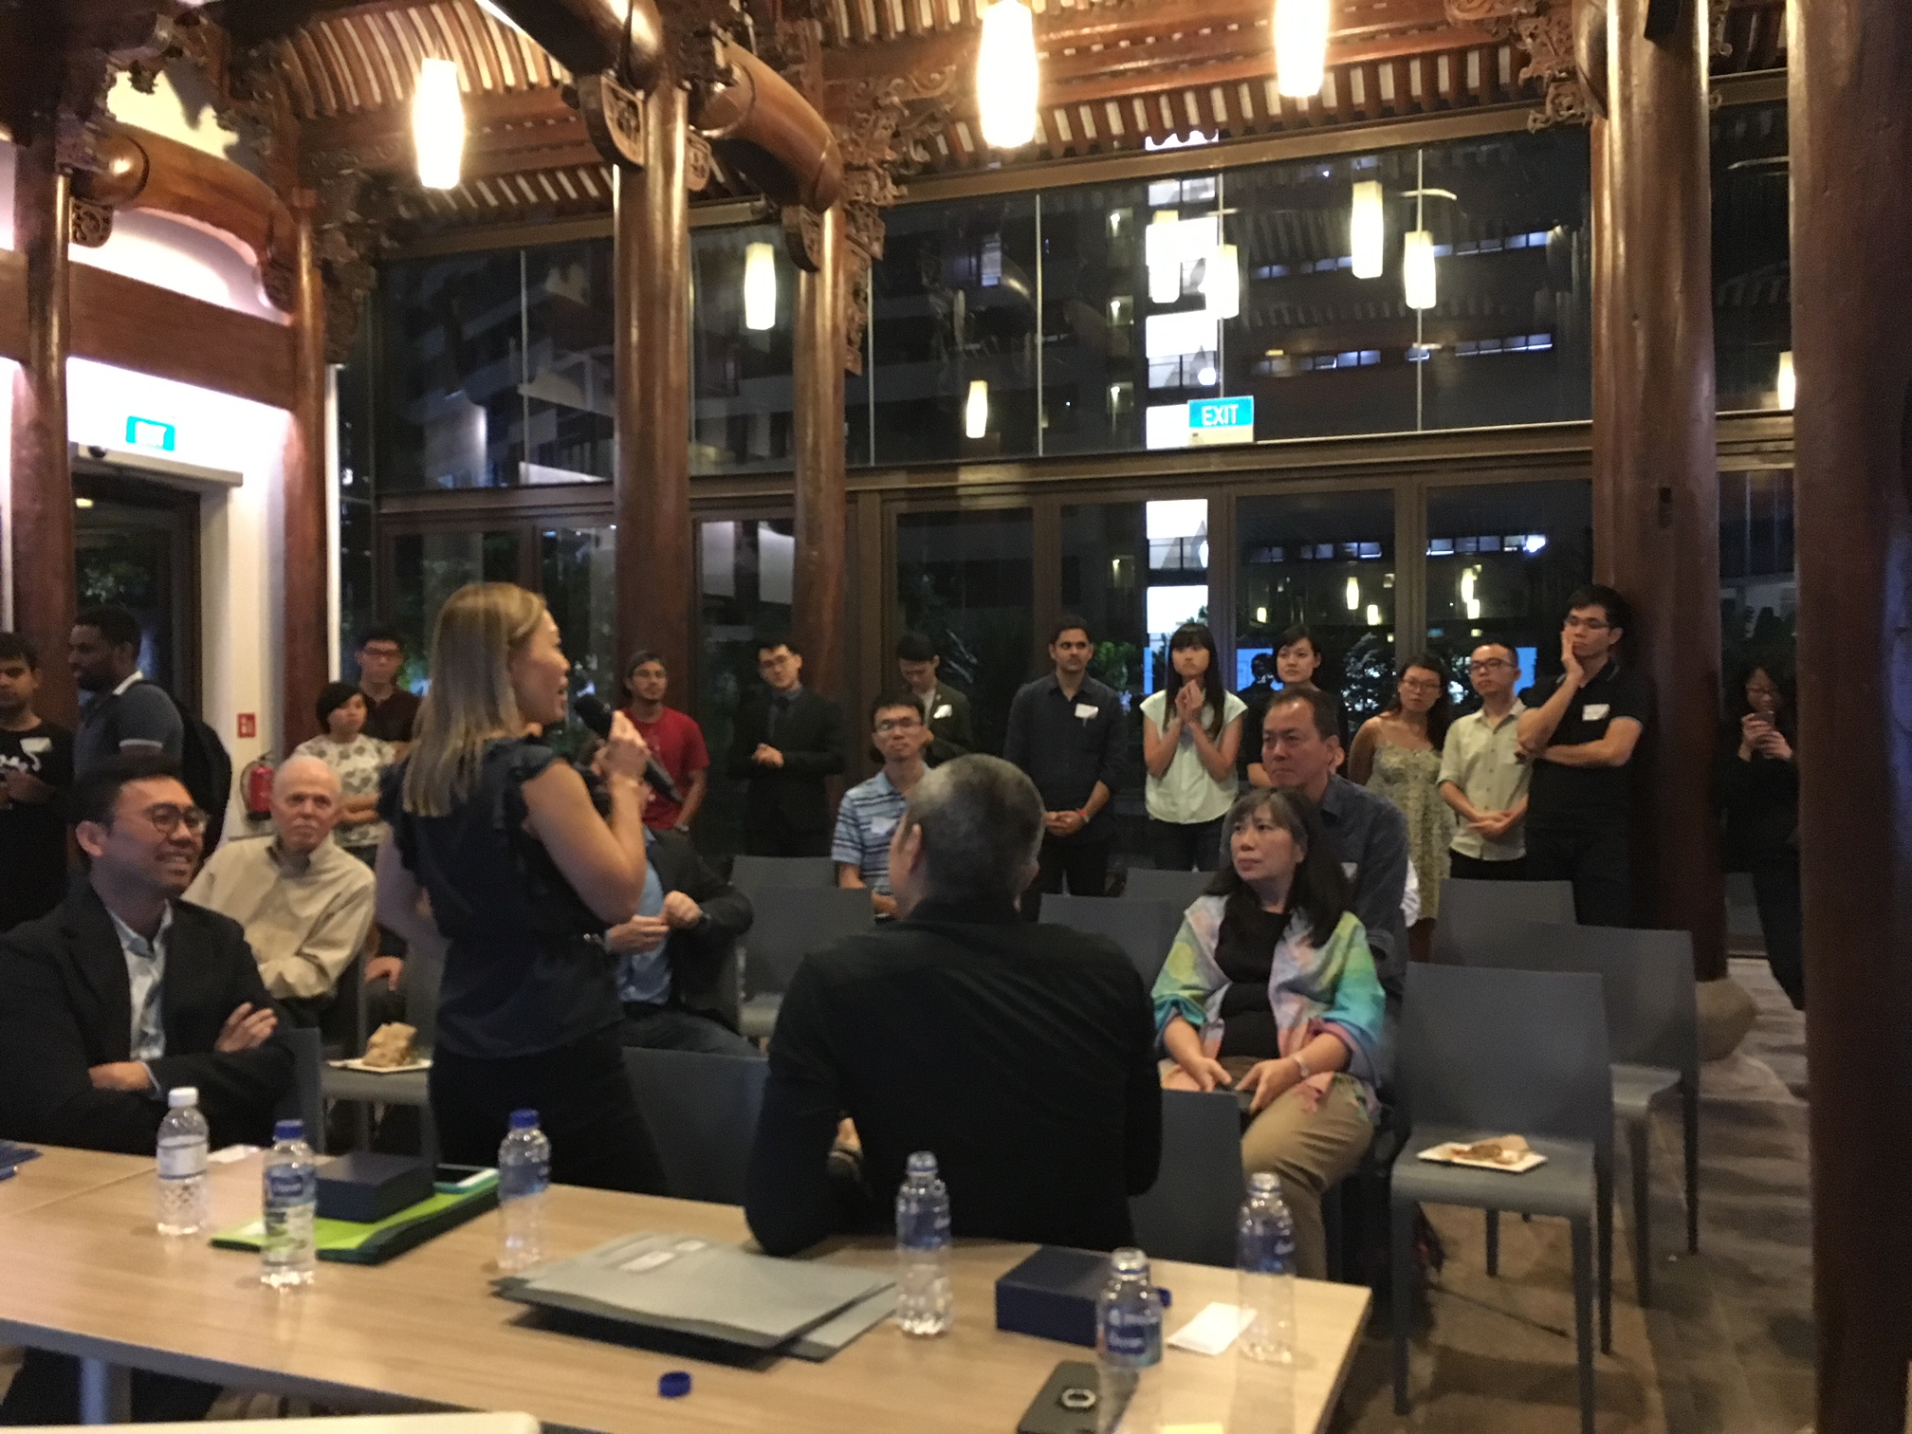
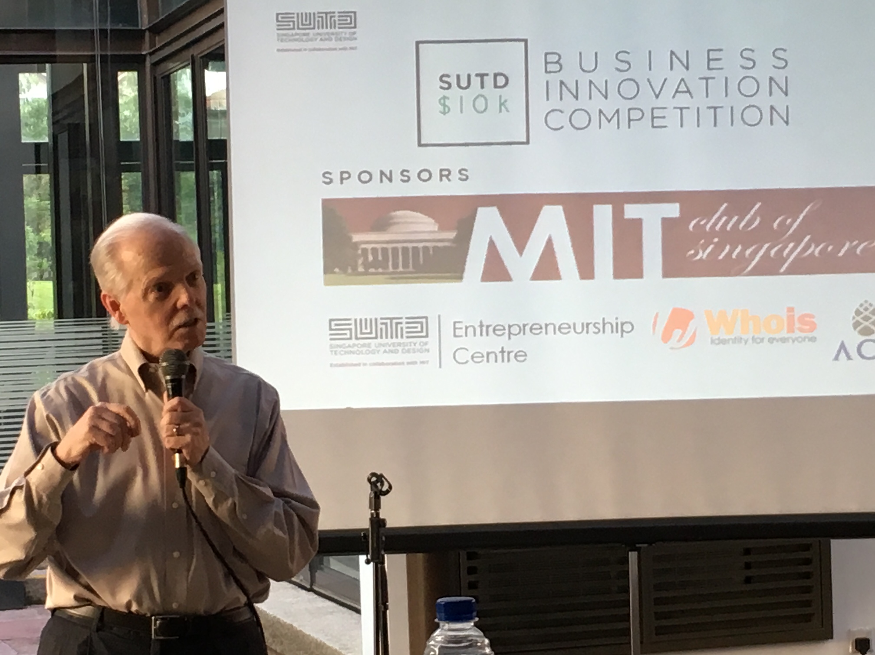
The SUTD Entrepreneurship Centre started supporting the event
Opened up all the EC’s training sessions to 10K teams
Started incubating high potential ideas
SUTD President Tom Magnanti made keynote address
2nd Edition of the SUTD 10K, April 2017

Slide 6
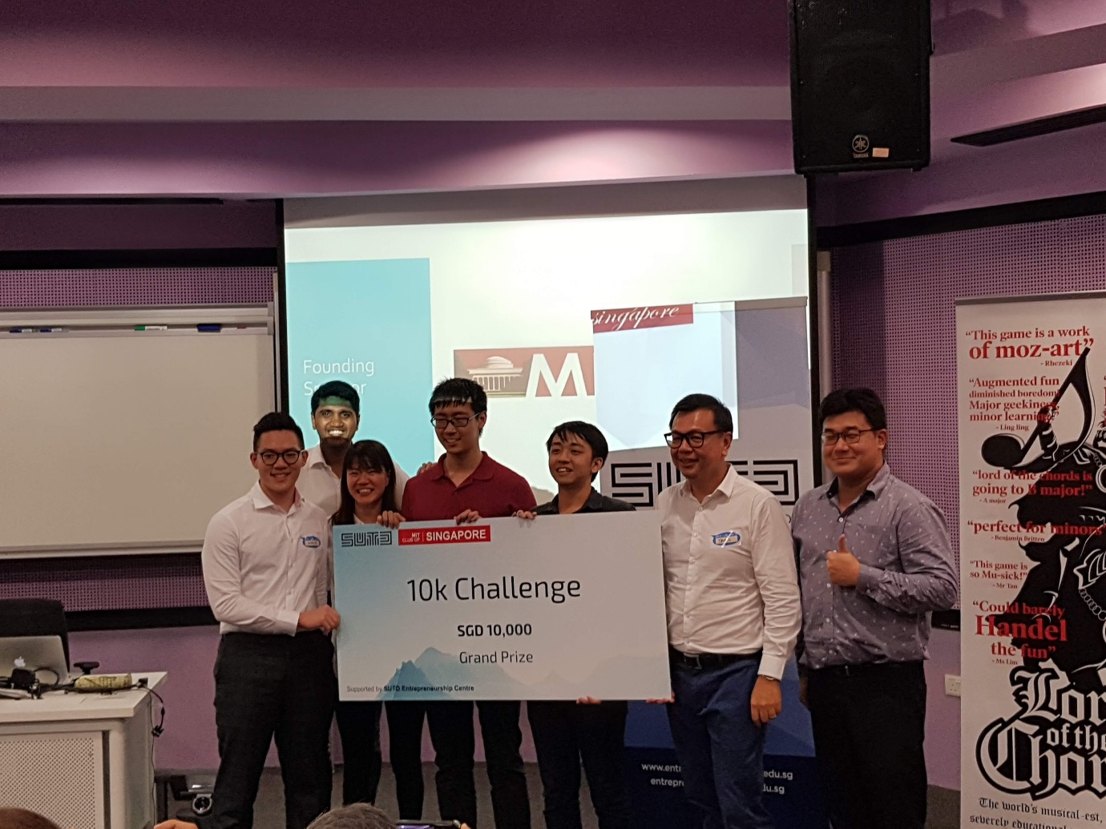
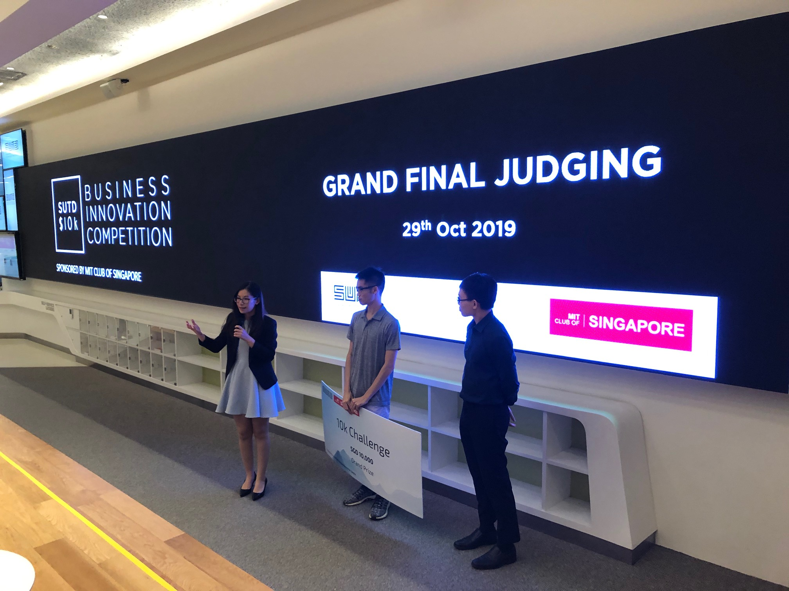
Subsequent editions of the 10k attracted close to 20 entries each year
The process is a big learning experience for students, even if they do not win (2018 winning team Beep above)
Many submissions, such as Tello, above, have great social impact potential

Slide 7
Almost all SUTD 10K winners are still pursuing their business ideas fulltime!
YEAR | TEAM | CONCEPT | CURRENT STATUS | Fund Raising
2016 | Rehub | Device for Remote monitoring of physical rehab patients | NA
2017 | Whyre | Motorcycle safety helmet with rear facing camera and HUD linked by bluetooth | Live company | Successful crowdfunding exercise in 2019
2018 | Beep | Multiplatform payment interface for vending machines | Live company | Works with majority of Singapore vending machine operator. (Deployed 30 units)
2019 | Tello | Communication tool for stroke patients and locked in syndrome | Live company | Working with AWWA to rollout Beta
Several other finalists have also continued their entrepreneurial journey and secured VC financing

Slide 8
Others achievements by SUTD 10k Challenge Participants
TEAM | CONCEPT | CURRENT STATUS | Fund Raising
Edgebotix | Pivoted from education robot to AI for autonomous vehicle | Live Company | Raised funding with Silicon Solution Partner
Bifrost | Changing the way AI understands the world using synthetic data. | Live company | Top-30 Teams of Slingshot 2019; selected for the Techstars Space Accelerator program based in CA
Novocall | Enables an immediate callback to consumers who have shown interest in a particular website or product, based on their website behaviour. | Live company | Raised funding with 500 Startups
Lord of The Chords | A Fun concept to teach music theory | Development | Successful Kickstarter Campaign

Slide 9

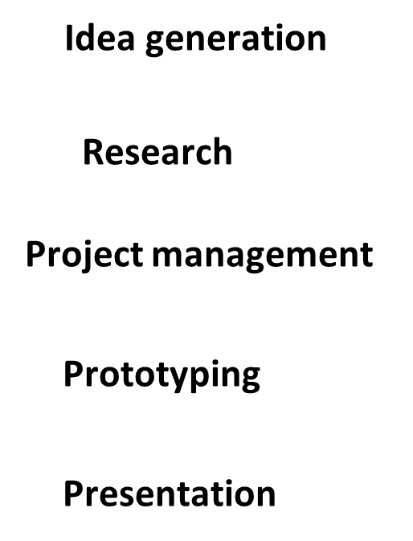
MIT Club Singapore helps source for judges and mentors
Role of mentors:
To coach the team on their project idea
Give advice, guidance, and support to your team
Provide a view from relevant industry
Network to find beta customers

Slide 10
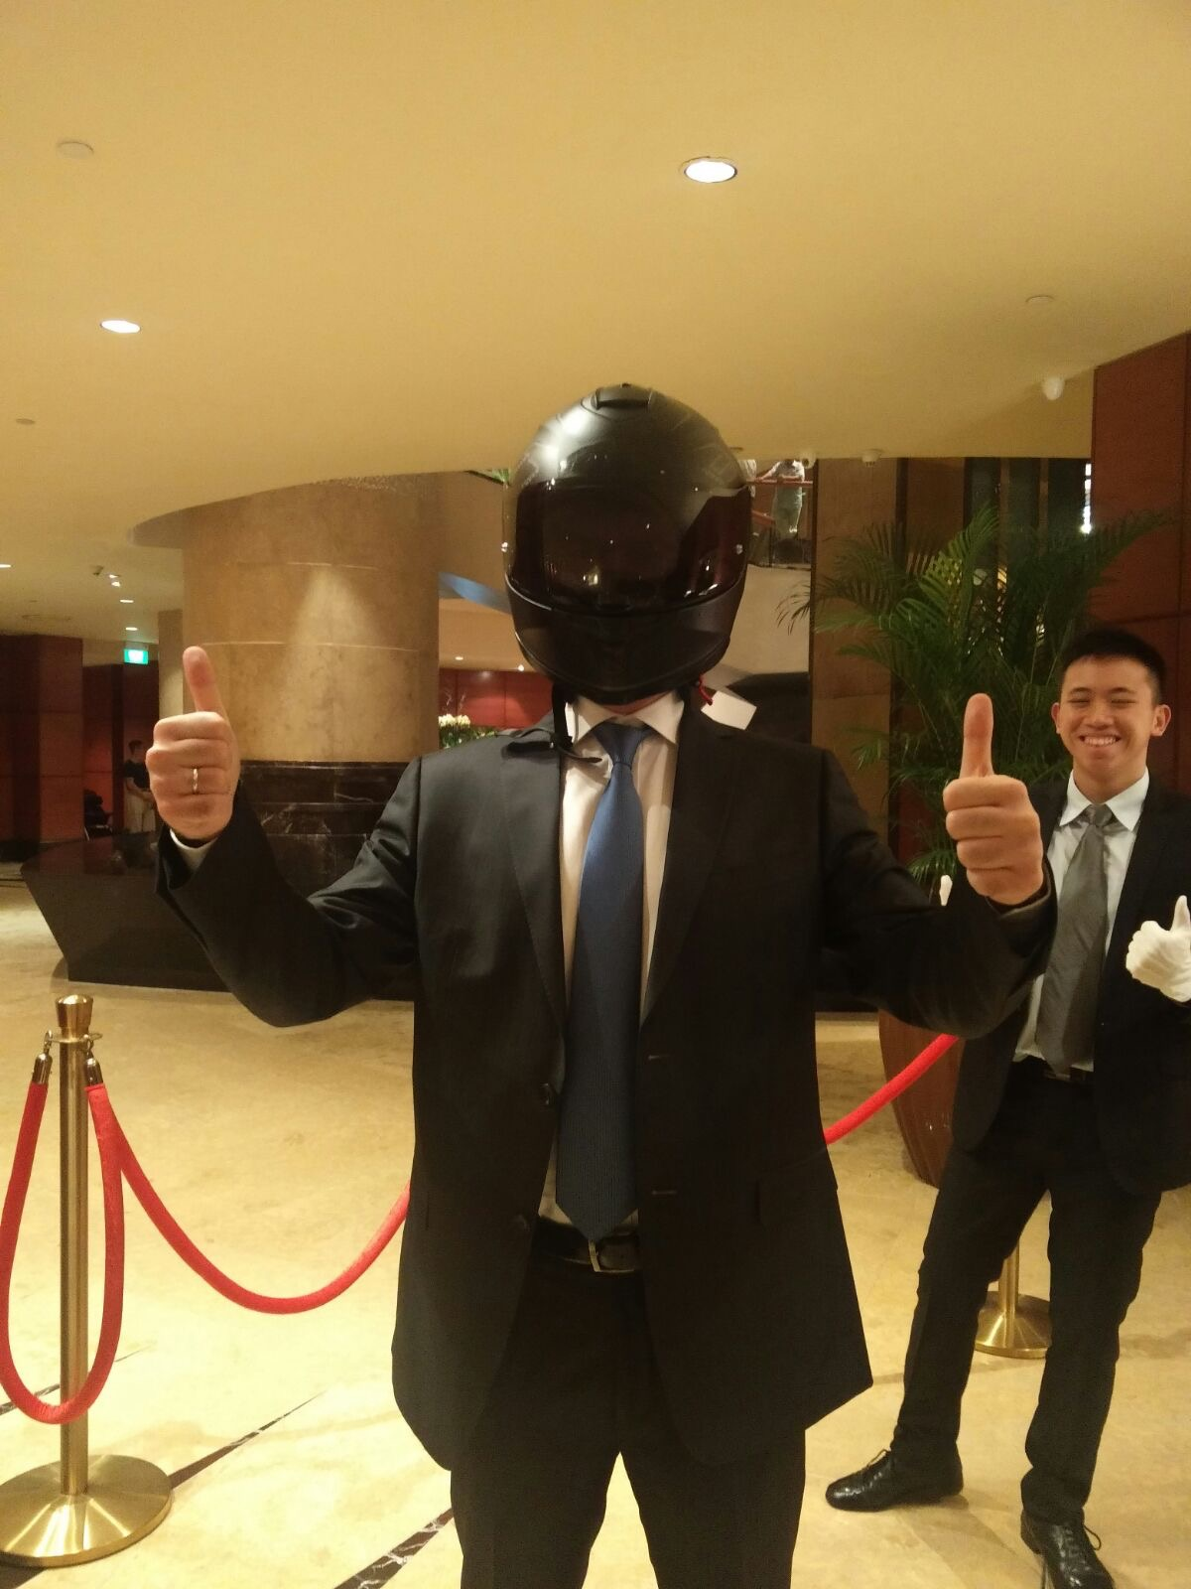
2017 10K Winner Whyre at MIT Club Gala Event

Slide 11
2021 to 2023
15K
Competition
Bring the 10K competition to NTU, NUS and SMU for an inter-school competition. Renaming it to 15K Competition.
To motivate more students and researchers to not only develop innovative technologies and processes, but to think about how to bring their ideas to market (must consider the business side).
15K Competition
Participation from NTU / NUS / SMU / SUTD
We will have 3 semi-final rounds with 2 teams advancing to the final round:
  NTU
  NUS & SMU
  SUTD

Slide 12
TIMELINE: 15K Competition 2022
NUS & SMU
START
END
Marketing
Project registrationapplication
Project evaluation
Mentoring
Semi-finals
Finals
Mid April – June
Mid Apr –
17 June
17 - 24 June
1 July –
16 Sept
16 Sept
15 Oct

Slide 13
2021 to 2023
15K
Competition
Participating Team Criteria:
2 to 4 students per team
At least one student (undergrad or grad) must be from NUS or SMU
Projects must be STEM related
Projects are in the ideation / prototype stage (has received less than $50K funding)

Slide 14
2021 to 2023
15K
Competition
Design Thinking Workshop:
The students are taught design thinking and must apply design thinking in their thought process and planning if they have not taken design thinking previously.
Competition Process:
Teams submit their ideas through a proposal template to their relative university’s coordinator
Top 10 ideas are selected for the mentorship phase and to present at the semi-finals
Top 2 teams from the semi-finals will advance to the finals

Slide 15
2021 to 2023
15K
Competition
Submission:
Students to submit their ideas by emailing to mrakoto@smu.edu.sg
Proposal template can be downloaded at CLICK HERE
Participants must address all the points listed in the proposal within a maximum limit of 10 pages. Pages in the Annex are not counted towards the page limits.

Slide 16
2021 to 2023
15K
Competition
Mentors:
Volunteer mentors will be recruited from MIT Club of Singapore and JA volunteers. Role of mentors:
To coach the team on their project idea
Give advice, guidance, and support to the team
Provide a view from relevant industry
Network to find beta customers

Slide 17
2021 to 2023
15K
Competition
Judging Criteria
Percentage | Criteria
30% | Strength of Idea: 10% Novel 10% Differentiated 10% Defensible
30% | Commercial Viability: 10% Target Addressable Market 10% Prototype 10% Customer Validation
20% | Teamwork: 10% Team Composition 10% Work / Progress Demonstrated
20% | Presentation: 10% Clearly communicates research, findings and ideas 10% Each member contributes to the presentation.

Slide 18
2021 to 2023
15K
Competition
Prizes:
Semi-Finals
  Top 2 teams - $2K each
Finals
  1st Place - $15K & advance to the ATEC*competition
  2nd Place - $10K
  3rd Place - $5K
*ATEC (Asia Technology Entrepreneurship Conference) www.atecstartup.org

Slide 19
2021 to 2023
15K
Competition
NUS & SMU:
Marc Rakotomalala
mrakoto@smu.edu.sg

